Slide 1
TERM 4
English
GRADE 2 YEAR 2

Slide 2
LESSON PLAN CONTENT
WEEK 1-2 | WATER
WEEK 3-5 | OUR COUNTRY SOUTH AFRICA
WEEK 6-7 | COMMUNICATION IN OUR WORLD
WEEK 8-9 | LIFE AT NIGHT

Slide 3
Lesson objectives
Learners will be able to…
Discuss the water cycle
Save water
Water purification
Know the name of our country South Africa
Recognise the map of South Africa
Recognise the symbols of South Africa
Name own province
Name own town
Recognise the South African
flag and places where we can
see it flying. Meaning of colours
Listen/hum/sing South African

Slide 4
Lesson objectives cont…
Identify common communication skills
Identify common communication technologies
Identify ways that a person’s privacy and reputation may be compromised online
Identify examples of texting style language, including abbreviations and emoticons.
Describe the appropriate and inappropriate uses of texting style language.
Describe some potential consequences of the inappropriate use of texting style language
Discuss things they do at night get ready for bed, read and tell stories, sleep and dream
Identify people who work at night - such as security officers, doctors, pilots, truck drivers
Identify night animals - such as owls, hamsters, porcupines, leopards, jackal

Slide 5
ASSESSMENT GOALS
Know and discuss the water cycle using basic vocabulary
Know how to save water
Know and explain how water purification works
Know the province of residence
Know town of residence
Know and label the flag and the meaning of the colours
Know and sing/hum the anthem
Understand the term rainbow nation

Slide 6
ASSESSMENT GOALS cont…
Identify ways that a person’s privacy and reputation may be compromised online.
Identify examples of texting-style language, including abbreviations and emoticons.
Describe and discuss the appropriate and inappropriate uses of texting-style language.
Describe and discuss some potential consequences of the inappropriate use of texting-style language.
Identify, name and label people who work at night - such as security officers, doctors, pilots, truck drivers
Identify night animals - such as owls, hamsters, porcupines, leopards, jackal

Slide 7
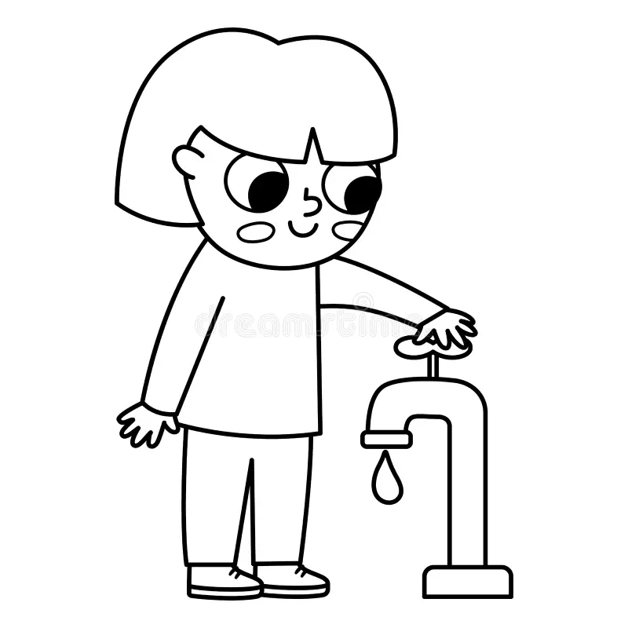
WATER

Slide 8
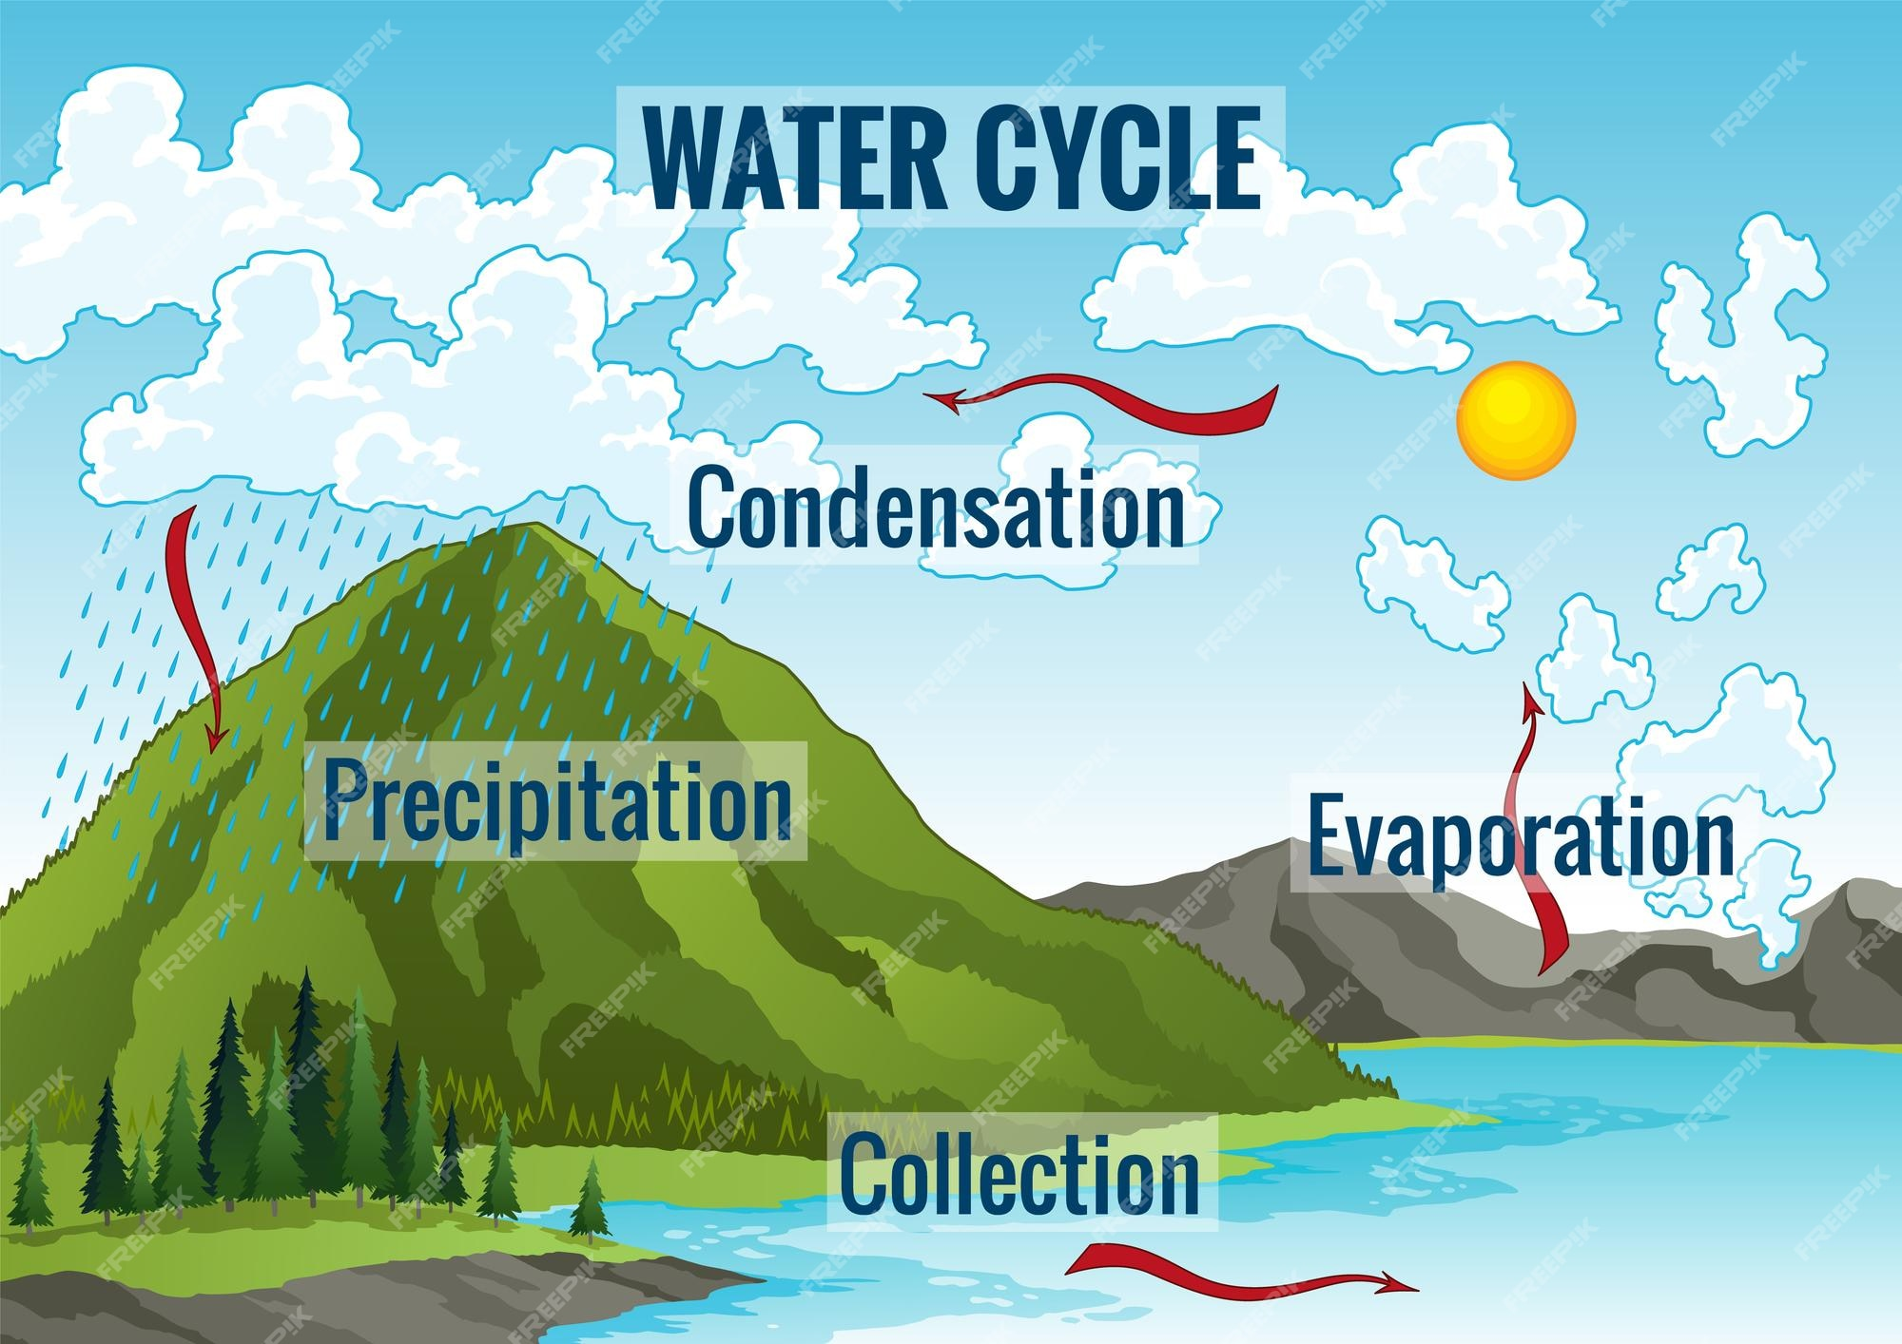
Introduction

Slide 9

Group 1
Colour the rain cloud using pencil colours

Slide 10
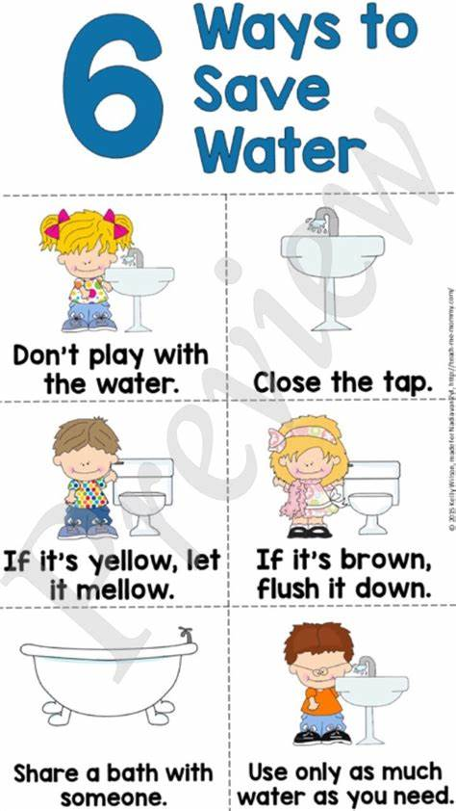
Practical task
HOW TO SAVE WATER

Slide 11
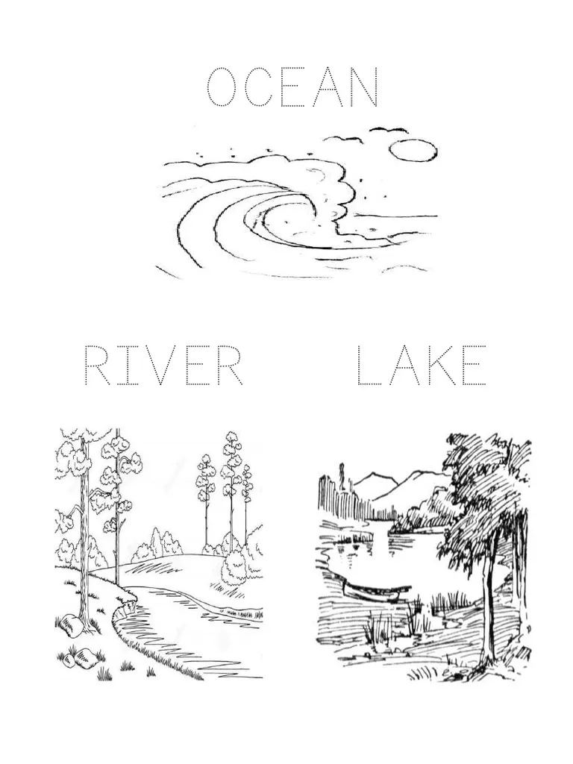
Trace the words on the picture

Slide 12
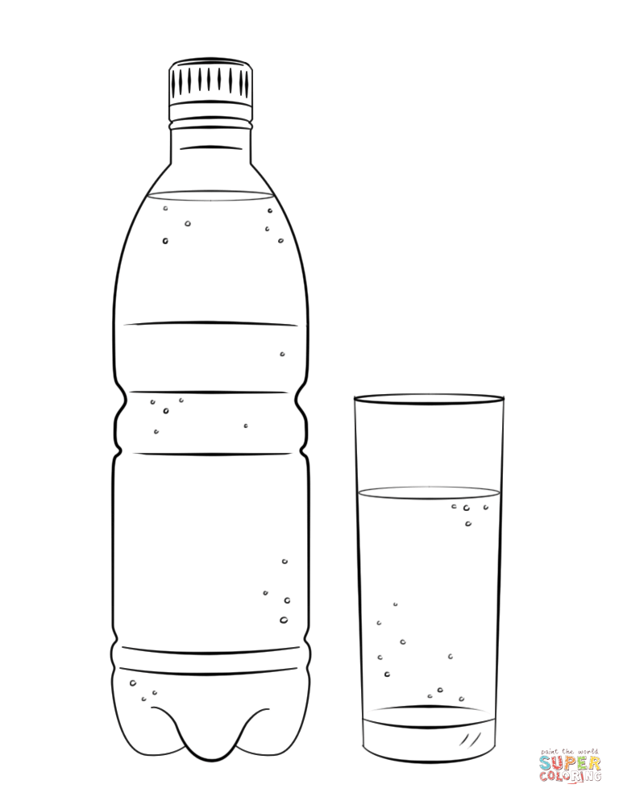
Colour in the water bottle picture below

Slide 13
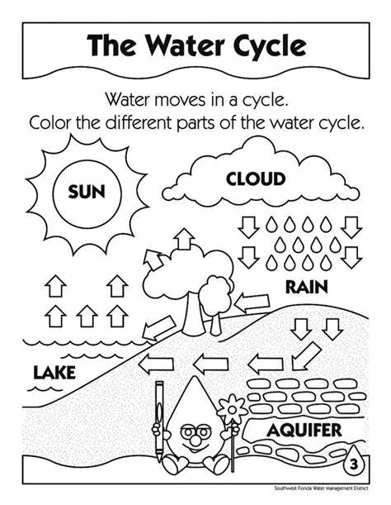
Group 2 water cycle

Slide 14
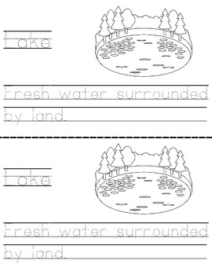
Trace words

Slide 15
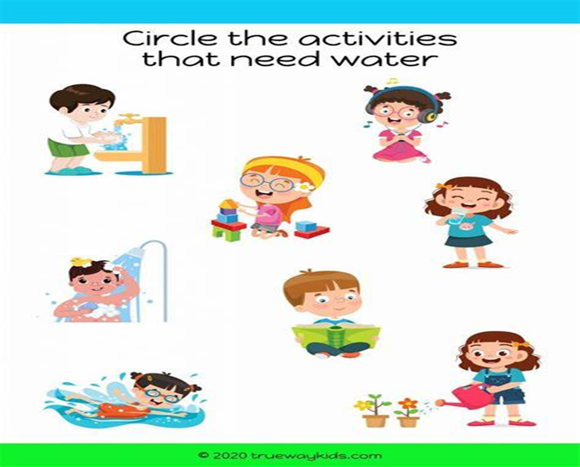

Slide 16
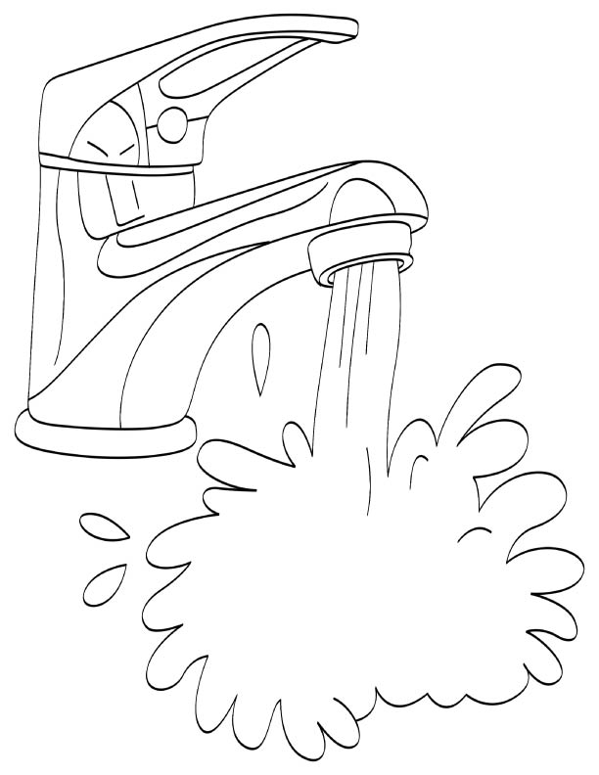
Where do we get water?
Colour the picture below

Slide 17
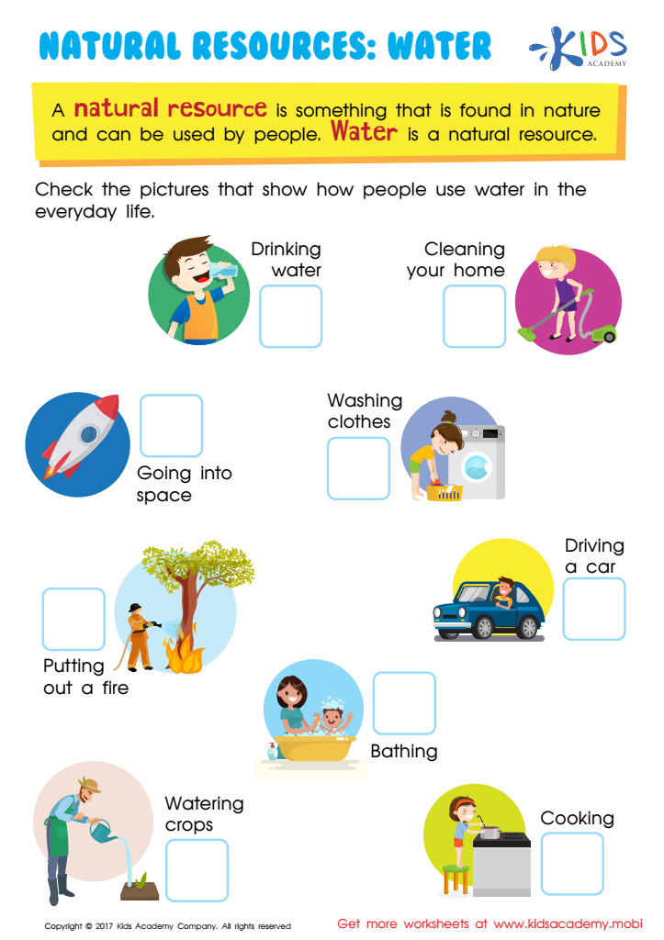
Group 3
Tick the images that shows the ways we use water

Slide 18
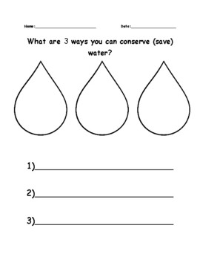
What are the 3 ways you can save water

Slide 19


Slide 20

GROUP 1
Colour the South African flag

Slide 21
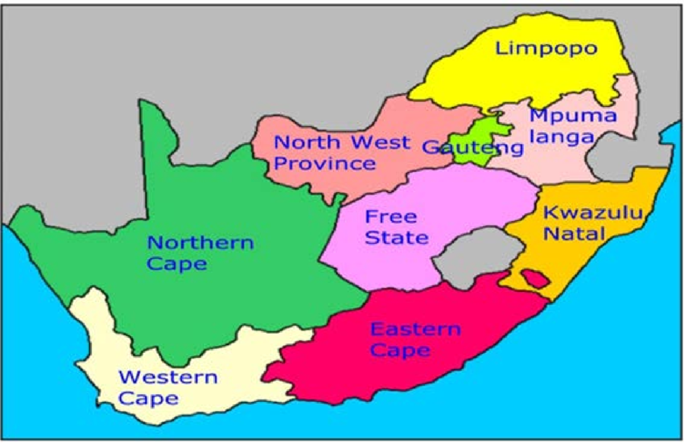
Point out 9 South African provinces

Slide 22

Group 2
Colour the South African flag

Slide 23
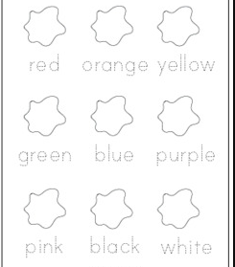
Trace the words and colour the 6 colours of South African flag

Slide 24
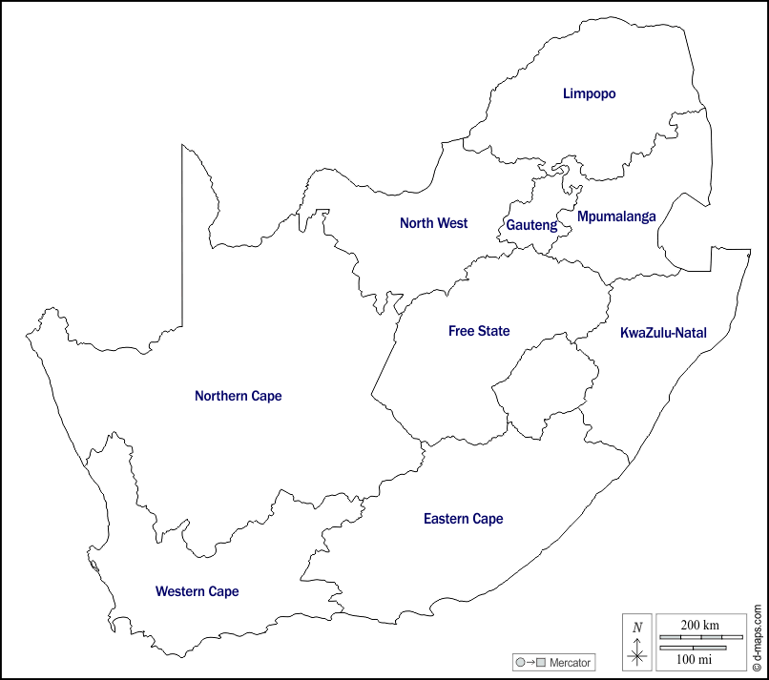
Colour 9 South African provinces

Slide 25
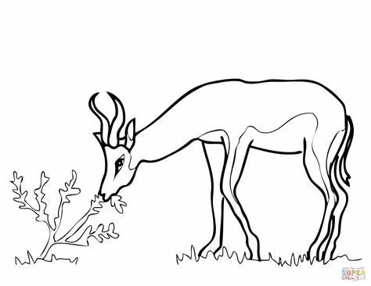
Colour the national springbok

Slide 26

GROUP 3
Colour the South African flag

Slide 27
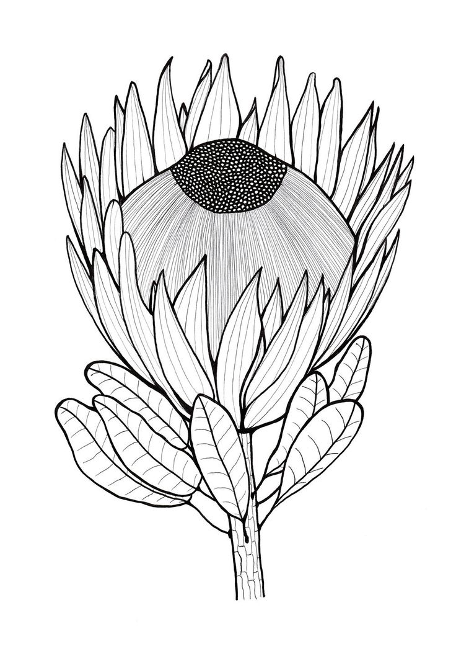
Colour in the protea national flower using different colours

Slide 28
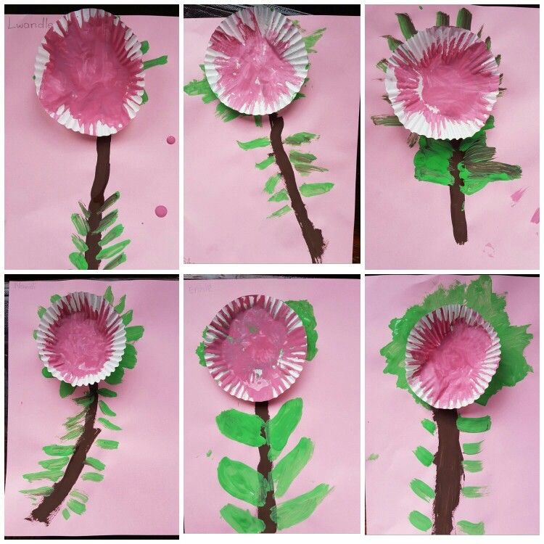
Practical work

Slide 29
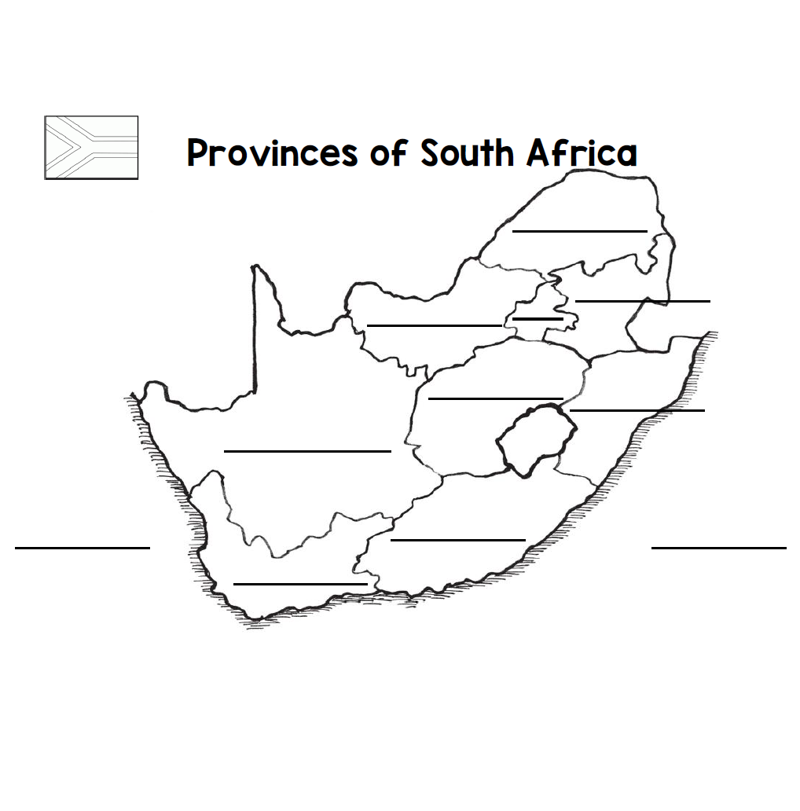
Complete and colour the map

Slide 30
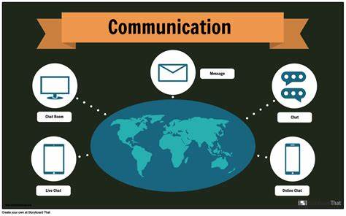
Communication in our world

Slide 31
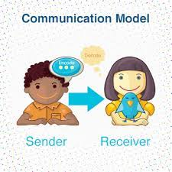
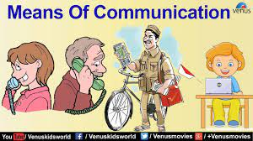
Introduction
What is communication?

Slide 32

Group 1
Colour in the telephone picture

Slide 33
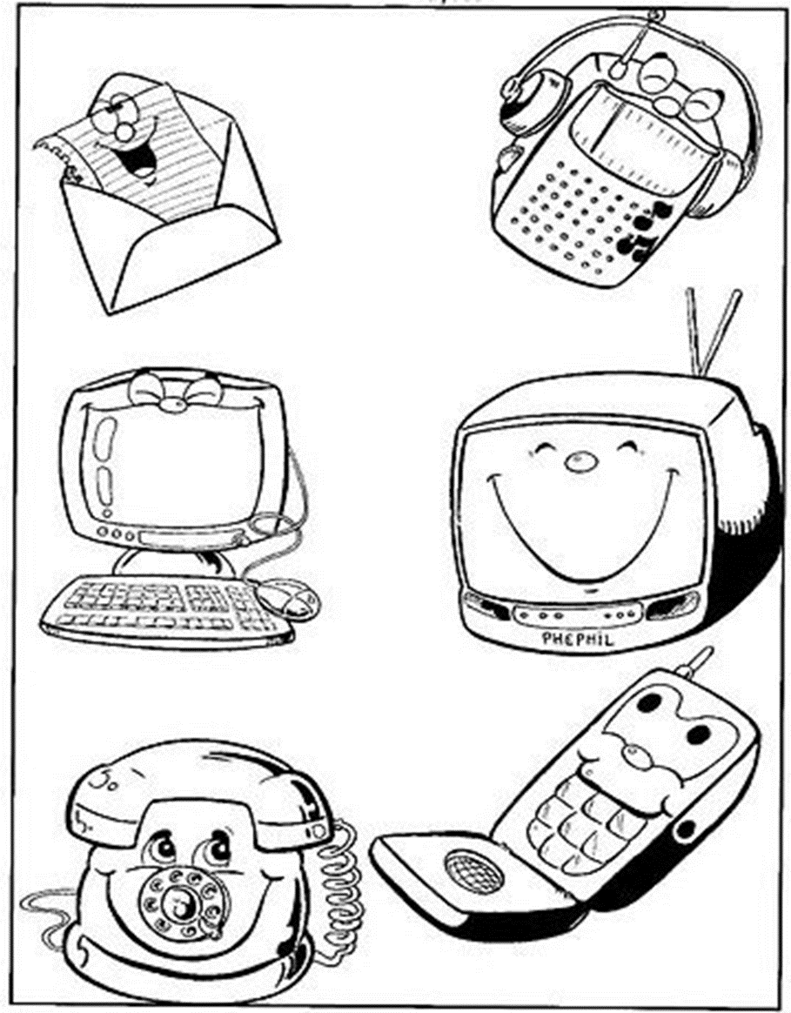
Colour in the picture below

Slide 34
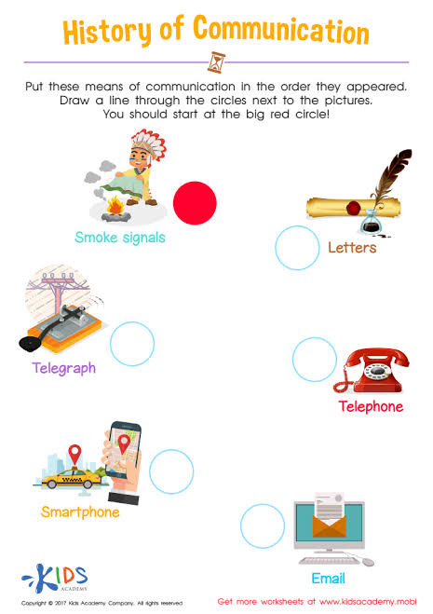
Group 2
Tick the correct form of communication that is used now

Slide 35
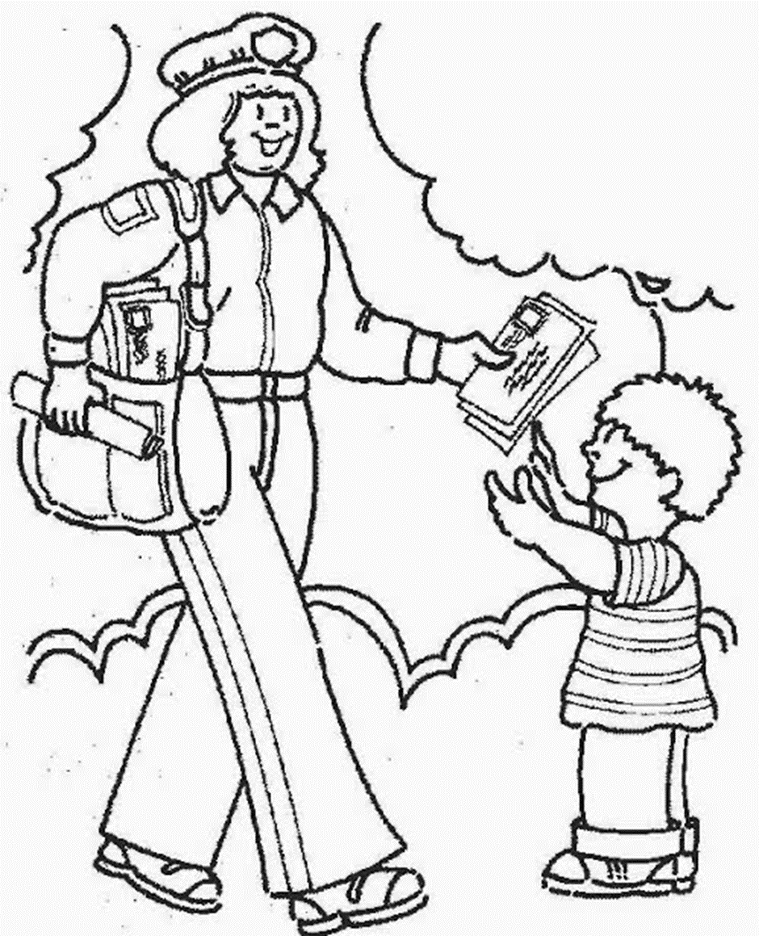
Colour in the mail communication picture below

Slide 36


Slide 37
Group 3
Draw any technology gadget that is used for communication

Slide 38
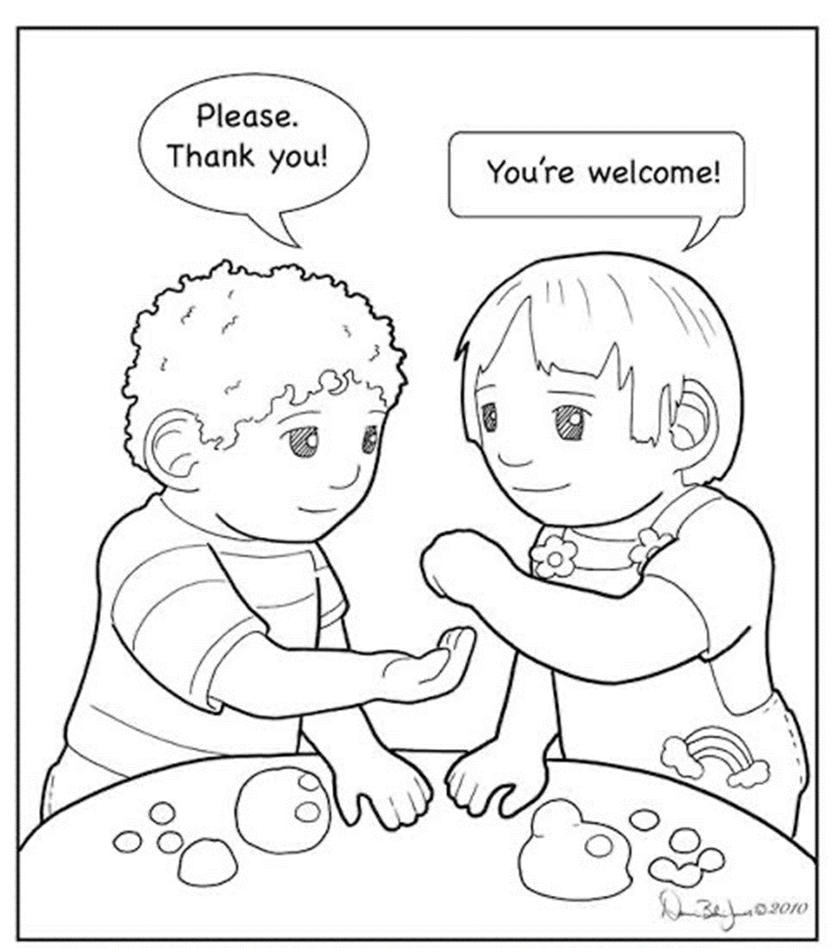
Colour in the picture of verbal communication

Slide 39
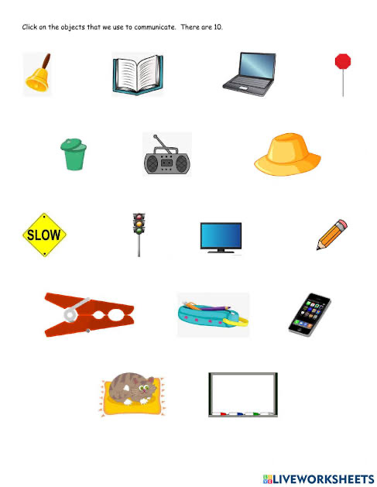
Circle the object that we use to communicate

Slide 40
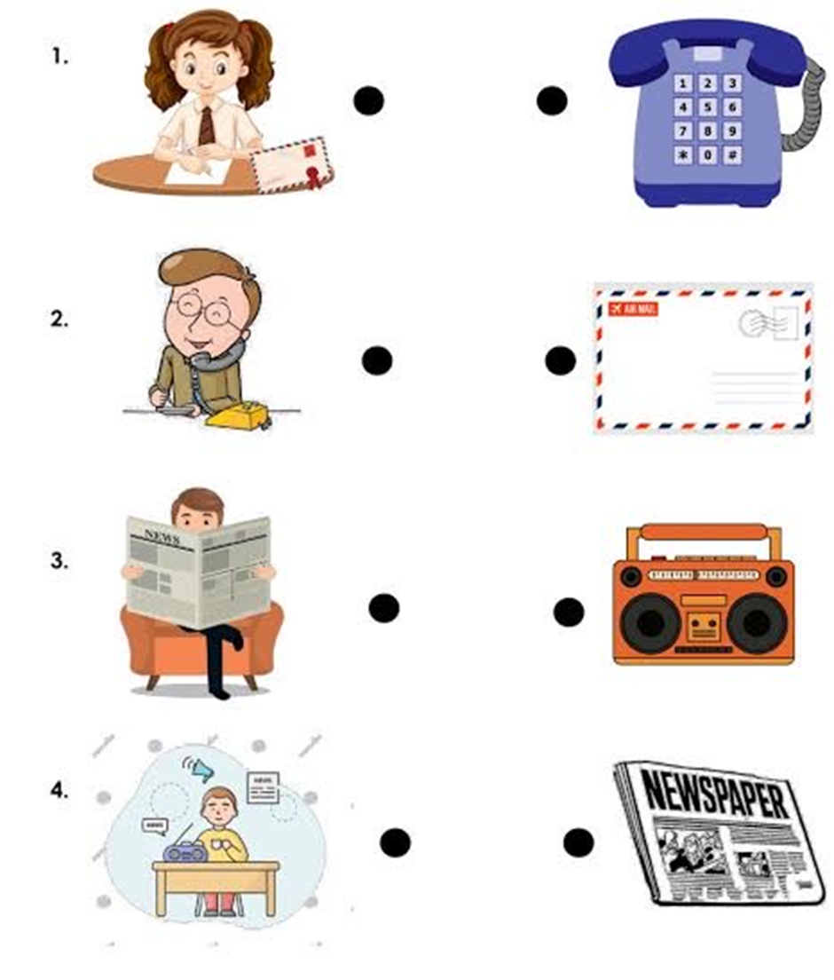
Draw lines to connect the pictures and matching communication tools

Slide 41
Rewrite the following sentences
I can talk on the phone with my friends.
____________________________________________
My father reads the newspaper everyday.
____________________________________________
I love listening to the radio.
____________________________________________
I can chat with my friends on my laptop.
____________________________________________

Slide 42

LIFE AT NIGHT

Slide 43

GROUP 1
Colour in the moon below

Slide 44

Colour in the star picture below

Slide 45

GROUP 2
Colour in the moon picture below

Slide 46

Trace and colour in the moon picture below

Slide 47
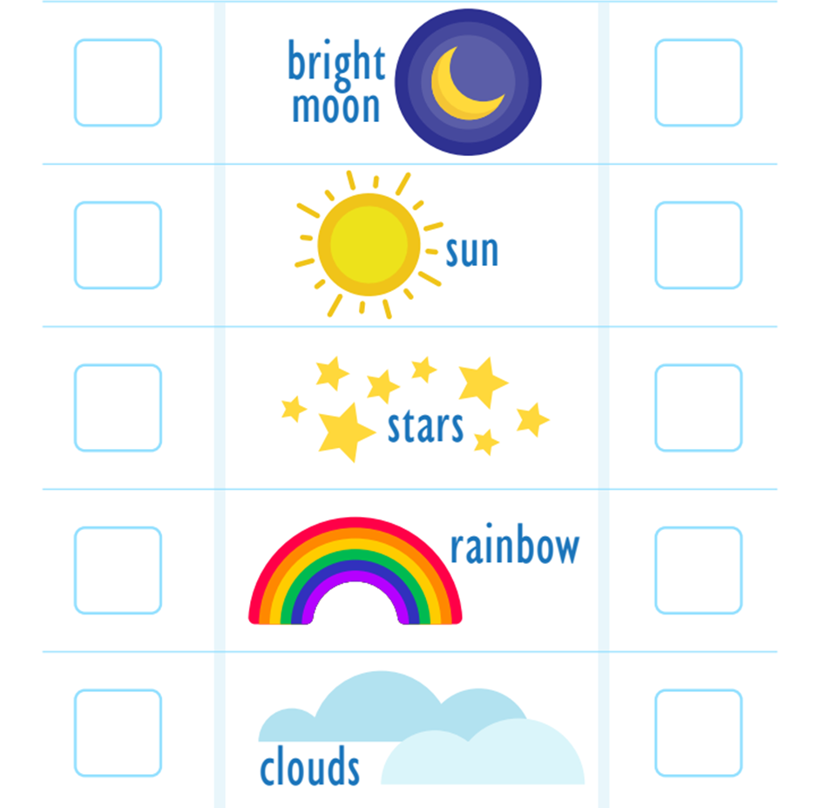
Tick the correct box of what we see at night and during the day

Slide 48
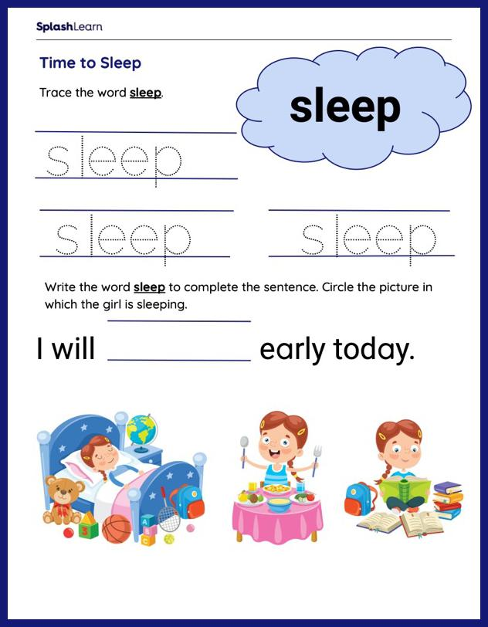

Slide 49
GROUP 3
Draw and colour in any image that represents the night

Slide 50



Colour the images that represent night life

Slide 51
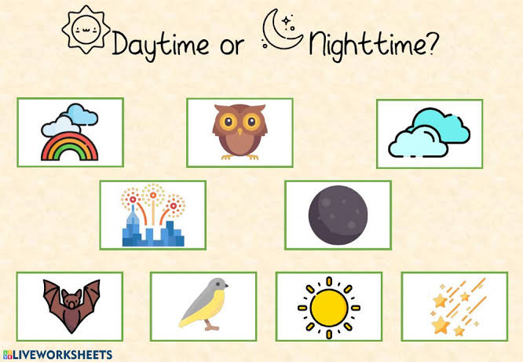
Tick√ the correct picture of night time

Slide 52


Slide 53
Rewrite the following sentences
My favourite time of the night is when I go to sleep
_______________________________________________________________
I do not play with my friends at night.
_______________________________________________________________
My baby brother has peaceful sleep at night.
_______________________________________________________________
My mother works nightshifts at work.
_______________________________________________________________

Slide 54
REFERENCE LIST
https://cdn4.vectorstock.com/i/1000x1000/81/78/transport-cartoons-vector-598178.jpg
https://th.bing.com/th/id/R.4bedde0a34a46c3f8476e8a9c3193ea9?rik=HzmXgDwWSMiEgg&riu=http%3a%2f%2fcdn.turtlediary.com%2fworksheets%2fela%2fpreschool%2fmiscellaneous%2fland-transport-match-the-parts%2fquestion%2fland-transport-match-the-parts-1.png&ehk=QmUIA1EFbE4f0svBv4Cz5sxyTCRyjPK21lGTtr58rpw%3d&risl=&pid=ImgRaw&r=0
https://www.kids-pages.com/folders/worksheets/Transportation/TransportationFillIn.jpg
https://th.bing.com/th/id/OIP.fRSAqPJELZxVQ3CRL-bfpgAAAA?rs=1&pid=ImgDetMain
https://th.bing.com/th/id/OIP.j1aGQgbLnwFPQ_I9JjVwygHaKe?w=178&h=252&c=7&r=0&o=5&pid=1.7
https://th.bing.com/th/id/OIP.sfoXR83NPVP-oQz6Fw5fKgAAAA?w=178&h=241&c=7&r=0&o=5&pid=1.7
https://th.bing.com/th/id/OIP.Nf6VTxle16YtwHqxzvj24QAAAA?rs=1&pid=ImgDetMain
https://th.bing.com/th/id/OIP.G22CAwskSgcV--pN-tS4-gAAAA?rs=1&pid=ImgDetMain

